Slide 1
The Battle of Neighborhood (Applied Data Science project)
Detecting location Information for Opening Indian restaurant in Toronto ,Canada

Slide 2
Introduction
Canada is a country in the northern part of
North America.
Canada contains the world's eighth largest
Indian Diaspora.
The largest group of Indian Canadians are of
Punjabi origin, accounting for around 50
percent of the Indo-Canadian population.

Slide 3
Business Problem
looking at the diverse Indian population in Canada, it’s a good Idea to start an authentic Indian restaurant to fulfill the taste demand of the Indian in Canada and extend the business of the restaurant chain across the boundaries.
Obviously , The Restaurant owners would be very interested in getting the location information of various areas that will be beneficial for them to open a new authentic Indian Restaurant.

Slide 4
To find a the answers to following:
List all major parts of Toronto that already have Indian restaurants.
Find the best location in Toronto for Indian Cuisine.
Find areas in Toronto have Potential Indian restaurant Market.
Find areas in Toronto that lack Indian restaurants.

Slide 5
Data acquisition and cleaning
Toronto City data that contains the list Boroughs, Neighborhood and Postal Code.
Data Source : https://en.wikipedia.org/wiki/List_of_postal_codes_of_Cana da:_M
Data Source: http://cocl.us/Geospatial_data.
Description: These data sets collectively contain the required information. And we will use this data set to explore various neighborhoods of Toronto.

Slide 6
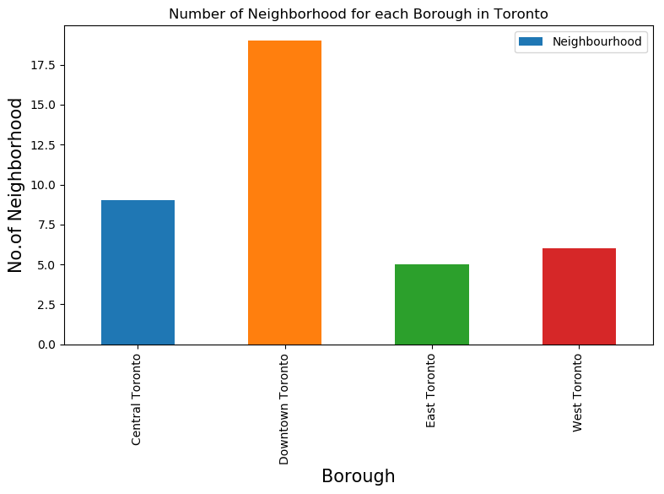
Finding the Neighborhoods different Bouroughs

Slide 7
No. of Indian Restaurant Neighborhoods
Neighborhood | No. of Restaurant
Business reply mail Processing Centre, South Central Letter Processing Plant Toronto | 2
Christie | 1
Davisville | 2
Davisville North | 2
Dufferin, Dovercourt Village | 2
Forest Hill North & West, Forest Hill Road Park | 2
High Park, The Junction South | 2
India Bazaar, The Beaches West | 3
Lawrence Park | 1

Slide 8
No. of Indian Restaurant Neighborhoods
Neighborhoods | No. of Restaurant
North Toronto West, Lawrence Park | 3
Parkdale, Roncesvalles | 2
Roselawn | 3
Runnymede, Swansea | 2
Studio District | 1
Summerhill West, Rathnelly, South Hill, Forest Hill SE, Deer Park | 1
The Annex, North Midtown, Yorkville | 1
The Beaches | 2
The Danforth West, Riverdale | 1

Slide 9
Areas having established Indian Restaurant Market.
Davisville.
India Bazaar, The Beaches West
North Toronto West, Lawrence Park
Roselawn
Since these are the neighborhoods with
greatest no. of Indian restaurant. It is clear that
they have an established market.
So if some on prefer to have Indian Cuisine they
should prefer to stay in such Neighborhoods.

Slide 10
Areas having lack of Indian Restaurant
The following areas comparatively lack in the
no. of Indian Restaurant.
Christie.
Studio District.
Summerhill West, Rathnelly, South Hill, Forest Hill SE, Deer Park.
The Annex, North Midtown, Yorkville.
The Danforth West, Riverdale.

Slide 11
Finding the Restaurant Ratings by the customers
Customer review and ratings of a venue are the most trust worthy measure for the goodness and quality of the venue.
In the scope of this project the customers ratings are used to find the most rated and best restaurant for Indian cuisine.

Slide 12
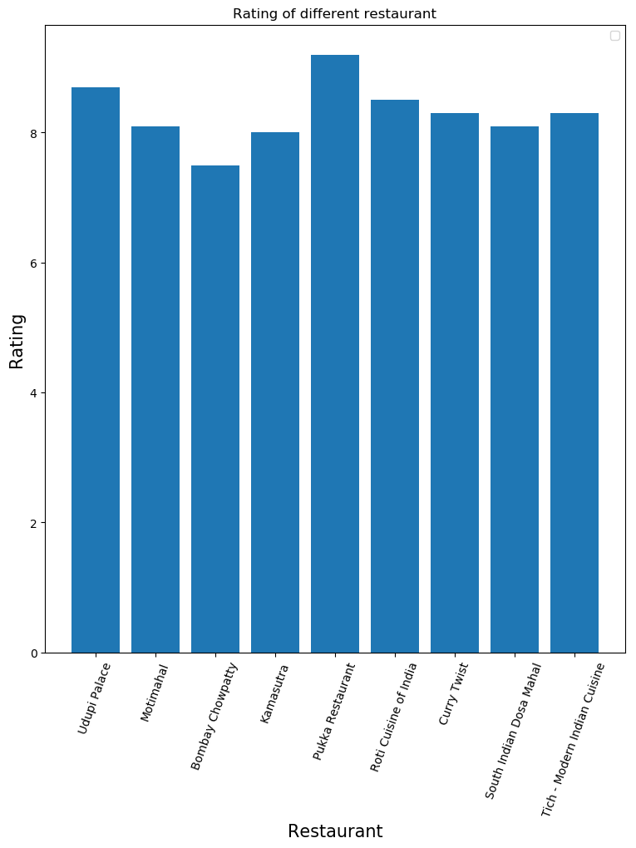
Rating of different Indian Restaurant

Slide 13
Conclusions
we have listed the Neighbourhood which have an established Indian Restaurant Market.
we have found the best locations in Toronto to have Indian Cuisine, which is Pukka Restaurant. since there are multiple branches of Pukka Restaurant one could try any of the following:
Pukka Restaurant ,Davisville North .
Pukka Restaurant ,North Toronto West, Lawrence Park.
Pukka Restaurant ,Summerhill West, Rathnellye, South Hill.
Pukka Restaurant ,Roselawn.
Pukka Restaurant ,Forest Hill North & West, Forest Hill Road Park.
Pukka Restaurant ,The Annex, North Midtown, Yorkville.
Pukka Restaurant ,Christie.
Pukka Restaurant ,Dufferin, Dovercourt Village.
Pukka Restaurant ,High Park, The Junction South.
Pukka Restaurant ,Parkdale, Roncesvalles.
we have found best places to stay if you prefer to have Indian Cuisine.

